Slide 1

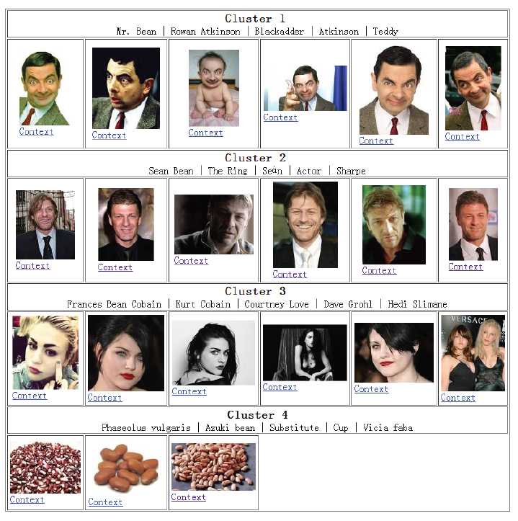
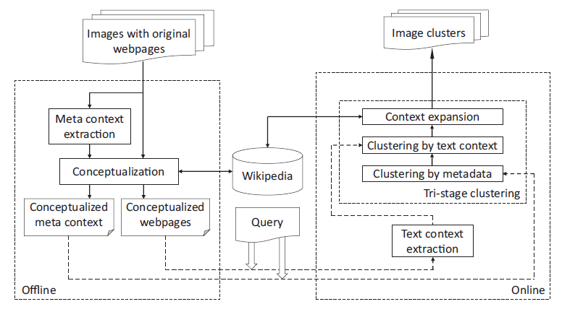
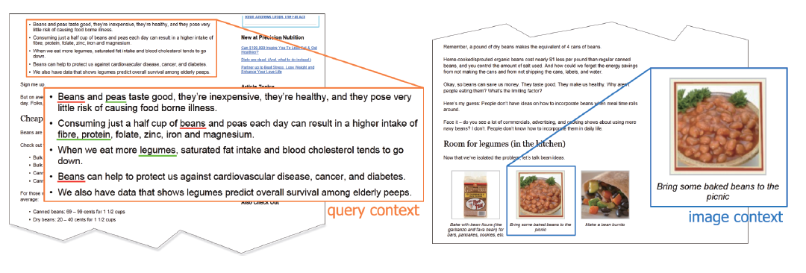
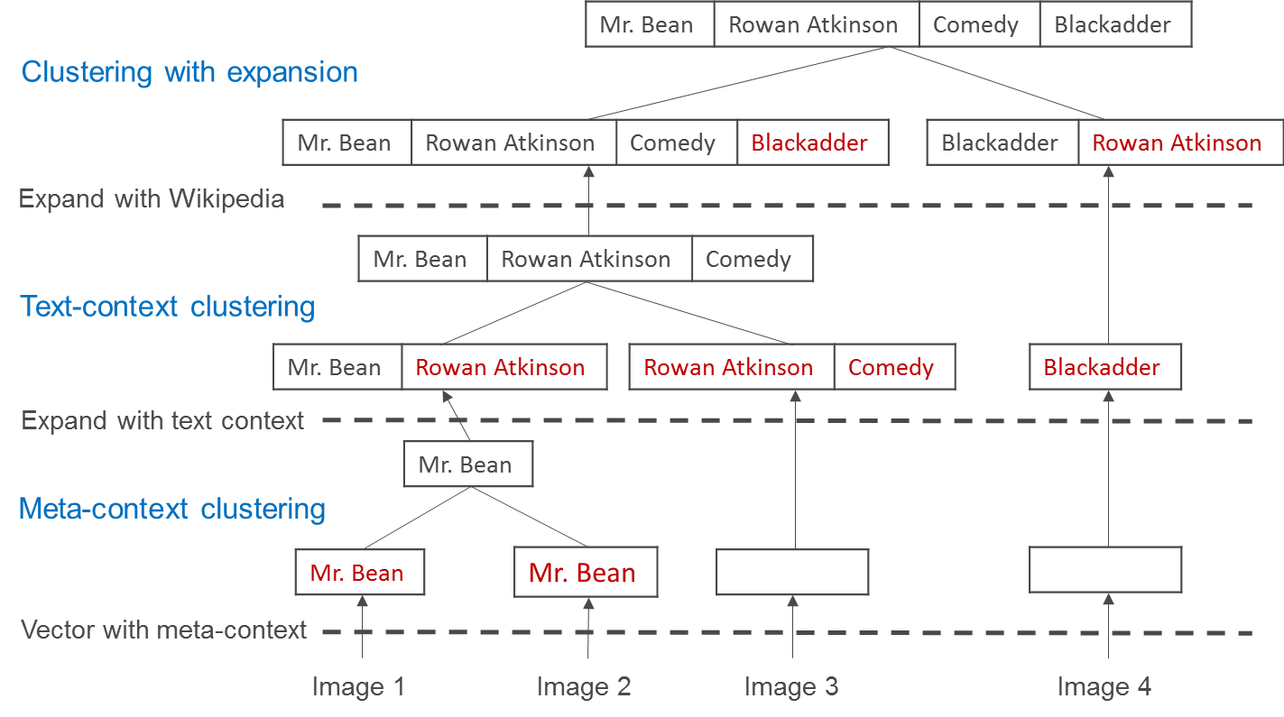
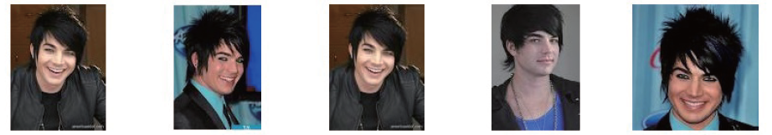
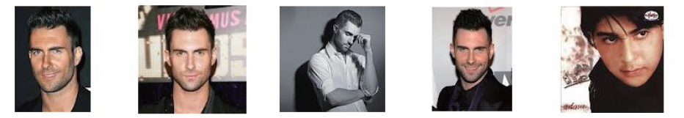
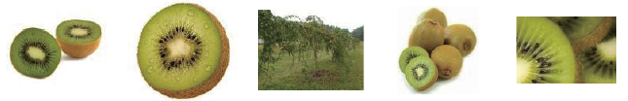
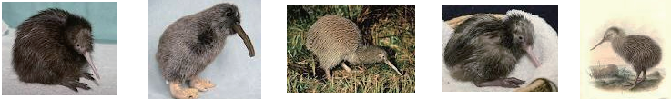
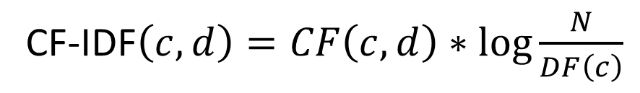
Clustering Image Search Results by Entity Disambiguation
Kaiq Zhao, Zhiyuan Cai, Qingyu Sui, Enxun Wei, Kenny Q. Zhu
Shanghai Jiao Tong University
Abstract
Motivation
We propose a novel framework that understands the context and thus infers the most likely entity in the given images by disambiguating the terms in the context into the corresponding concepts from external knowledge in a process called conceptualization. The images can subsequently be clustered by the most likely associated entities. The framework also automatically annotates each cluster of images by its key entities which allows users to quickly identify the images they want.
Image searching results are usually mixed with more than one entities which are related to the query term. For example, if we search for “bean”, we get the search result as in Figure 1.
Framework
As shown in figure 3, our framework consists of two parts: offline and online.
Offline component comprises:
Meta context extraction
Conceptualization
Online component comprises:
Text context extraction
Tri-stage clustering
Figure 1. Search result for “bean”
Figure 2. Clustered result for “bean”
It is hard for a user to find out a particular entity from the images, However, a clustered result as shown in Figure 2 could help users quickly find out the entity they are interested in.
Clustering with Cluster Conceptualization
Figure 3. Framework
In hierarchical agglomerative clustering algorithm (HAC), the similarity between two clusters is computed using one of the four methods: single-link, complete-link, centroid and group average. To enable summarizing the semantics of clusters, we instead conceptualize the clusters using the images in them. Specifically, we sum up all the image concept vectors to get the concept representation of the cluster. We use cluster concept representation to compute cluster similarity.
The text context is put online because the extraction of the context of the query term needs to be processed after the query comes.
Context Extraction & Representation
There are two kinds of context used in this paper: meta context and text context. Meta context comprises URL, alternative text or image title. Text context includes the surrounding text of the image and the query term in the web page. Figure 4 shows an example of image context and query context.
Tri-Stage Clustering
Our clustering algorithm contains three stages, each stage takes the output of the previous stage as input to further merge the clusters. The three stages are:
Stage 1: Clustering on meta data to form moderate initial clusters.
Stage 2: Clustering after expanding the cluster concept vectors by the text context
Stage 3: Clustering after expanding the cluster concept vectors using Wikipedia
An example is shown in Figure 6 to illustrate the process of merging clusters using tri-stage clustering algorithm.
Figure 4. Query context & image context
The red terms are the new concepts added to the concept vector. This example shows that two clusters may become similar after the concept vectors are enriched by more information.
We represent the context by conceptualizing the context to a concept space. Specifically, we link the terms in the context to Wikipedia concepts using a Wikification technique[1]. Each Wikipedia concept is assign a score called concept frequency inverse document frequency
CF-IDF$\left(c, d\right)=CF\left(c, d\right)∗\log{\frac{N}{DF\left(c\right)}}$
# of Wikipedia articles
(CF-IDF), which measures the importance of a concept to the image’s source page. The definition of CF-IDF is shown in Figure 5.
Concept frequency of c in the context d
Figure 5. CF-IDF
Document frequency of c in the whole Wikipedia corpus
Figure 6. An example of tri-stage clustering
Accuracy Evaluation
Example Outputs
We evaluate our framework on 50 query terms, and 100 images returned by the search engine and use purity, F1 and NMI as metrics.
Key Components:
Peers:
We compare our framework to some existing methods and two baselines:
Cai[2]: based on visual blocks
detection to extract context.
MMCP[3]: hybrid framework
of visual feature and BOW
Representation.
BOW with HAC
LDA (topic model) with HAC
We show two of the clusters for “adam” and “kiwi”, respectively, and 5 images as well as top 5 concepts for each cluster. We can also use these concepts as keywords to retrieve more images of one entity from search engine.
Clusters for “adam”
Images | Representative Concepts
 | Adam Lambert, American Idol, God, Kris Allen, Privacy policy
 | Adam Levine, Hijab, Mehndi, Fashion, Hairstyle
Different Contexts
Different Representations
Different Clustering Algorithms
Context | Purity | F1 | NMI
Whole page | 0.71 | 0.78 | 0.35
Image | 0.91 | 0.80 | 0.59
Image + Query | 0.90 | 0.81 | 0.62
Representation | Purity | F1 | NMI
Bag of words | 0.92 | 0.54 | 0.48
Bag of phrases | 0.94 | 0.62 | 0.50
Concept vector | 0.94 | 0.62 | 0.55
Algorithm | Purity | F1 | NMI | Time
AP | 0.92 | 0.55 | 0.50 | 1.9 s
HAC | 0.94 | 0.62 | 0.55 | 0.9 s
HAC_CC | 0.94 | 0.76 | 0.59 | 0.7 s
TSC | 0.90 | 0.81 | 0.62 | 1.1 s
Clusters for “kiwi”
Images | Representative Concepts
 | Kiwifruit, Fruit, Recipe, Health benefit, New Zealand
 | Kiwi, Bird, New Zealand, Egg, Smithsonian National Zoological Park
Peer Comparison
References
 | Cai | MMCP | BOW+HAC | LDA+HAC | TSC
Purity | 0.60 | 0.74 | 0.92 | 0.88 | 0.90
F1 | 0.71 | 0.58 | 0.54 | 0.60 | 0.81
NMI | 0.10 | 0.34 | 0.48 | 0.44 | 0.62
[1] Cai, Z., et al.: Wikification via link co-occurrence. CIKM 2013.
[2] Cai, D., et al.: Organizing www images based on the analysis of page layout and web link structure. ICME 2004.
[3] Fu, Z., et al.: Multi-modal constraint propagation for heterogeneous image clustering. MM 2011.

